Slide 1
Chapter 2: Operating-System Services

Slide 2
Outline
Operating System Services
User and Operating System-Interface
System Calls
System Services
Linkers and Loaders
Why Applications are Operating System Specific
Design and Implementation
Operating System Structure
Building and Booting an Operating System
Operating System Debugging

Slide 3
Objectives
Identify services provided by an operating system
Illustrate how system calls are used to provide operating system services
Compare and contrast monolithic, layered, microkernel, modular, and hybrid strategies for designing operating systems
Illustrate the process for booting an operating system
Apply tools for monitoring operating system performance
Design and implement kernel modules for interacting with a Linux kernel

Slide 4
Operating System Services
Operating systems provide an environment for execution of programs and services to programs and users
One set of operating-system services provides functions that are helpful to the user:
User interface - Almost all operating systems have a user interface (UI).
Varies between Command-Line (CLI), Graphics User Interface (GUI), touch-screen, Batch
Program execution - The system must be able to load a program into memory and to run that program, end execution, either normally or abnormally (indicating error)
I/O operations - A running program may require I/O, which may involve a file or an I/O device
File-system manipulation - The file system is of particular interest. Programs need to read and write files and directories, create and delete them, search them, list file Information, permission management.

Slide 5
Operating System Services (Cont.)
One set of operating-system services provides functions that are helpful to the user (Cont.):
Communications – Processes may exchange information, on the same computer or between computers over a network
Communications may be via shared memory or through message passing (packets moved by the OS)
Error detection – OS needs to be constantly aware of possible errors
May occur in the CPU and memory hardware, in I/O devices, in user program
For each type of error, OS should take the appropriate action to ensure correct and consistent computing
Debugging facilities can greatly enhance the user’s and programmer’s abilities to efficiently use the system

Slide 6
Operating System Services (Cont.)
Another set of OS functions exists for ensuring the efficient operation of the system itself via resource sharing
Resource allocation - When multiple users or multiple jobs running concurrently, resources must be allocated to each of them
Many types of resources - CPU cycles, main memory, file storage, I/O devices.
Logging - To keep track of which users use how much and what kinds of computer resources
Protection and security - The owners of information stored in a multiuser or networked computer system may want to control use of that information, concurrent processes should not interfere with each other
Protection involves ensuring that all access to system resources is controlled
Security of the system from outsiders requires user authentication, extends to defending external I/O devices from invalid access attempts

Slide 7
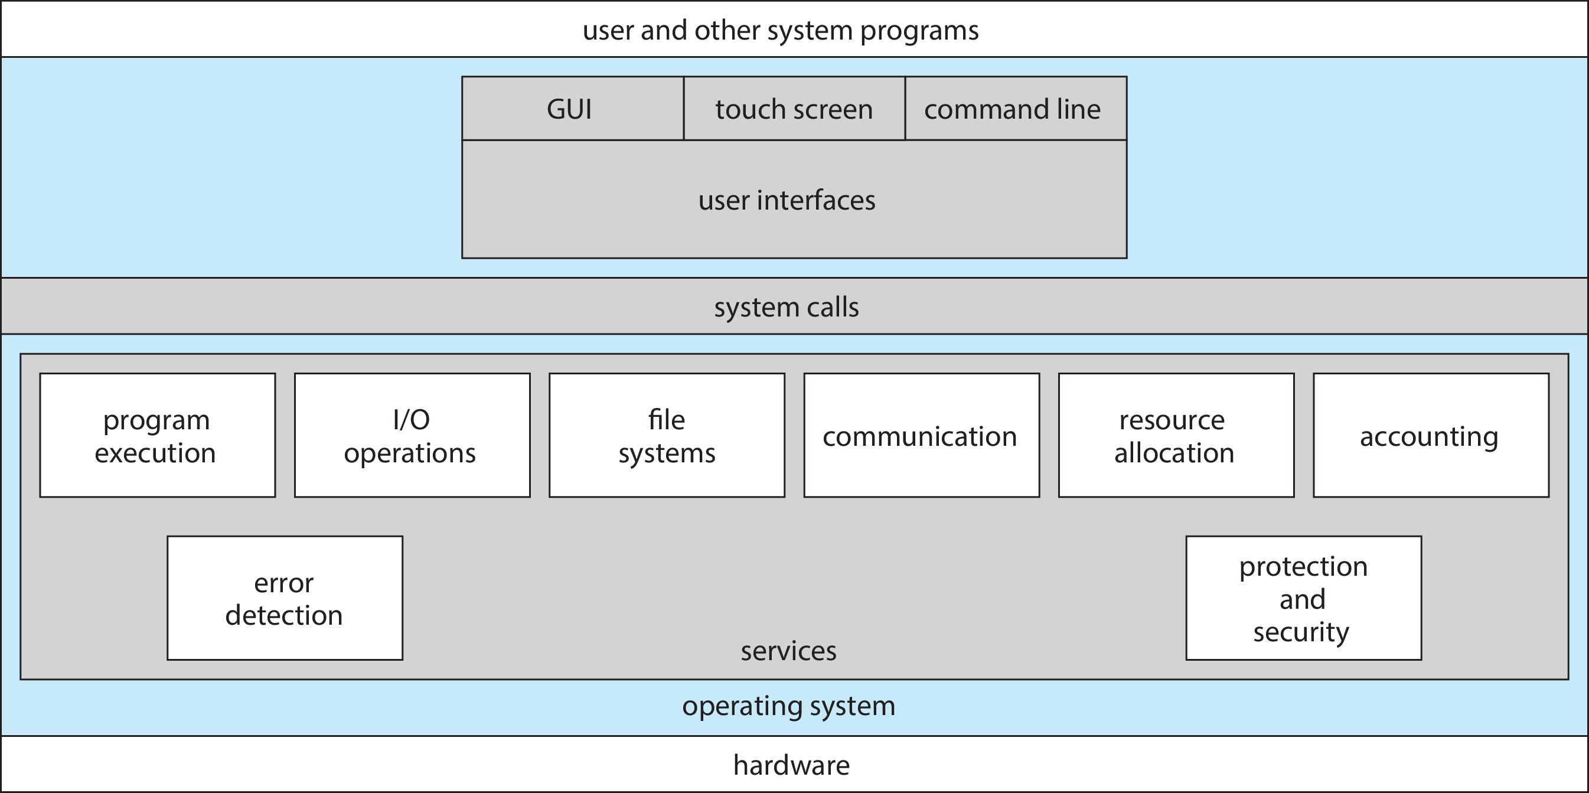
A View of Operating System Services

Slide 8
Command Line interpreter
CLI allows direct command entry
Sometimes implemented in kernel, sometimes by systems program
Sometimes multiple flavors implemented – shells
Primarily fetches a command from user and executes it
Sometimes commands built-in, sometimes just names of programs
If the latter, adding new features doesn’t require shell modification

Slide 9
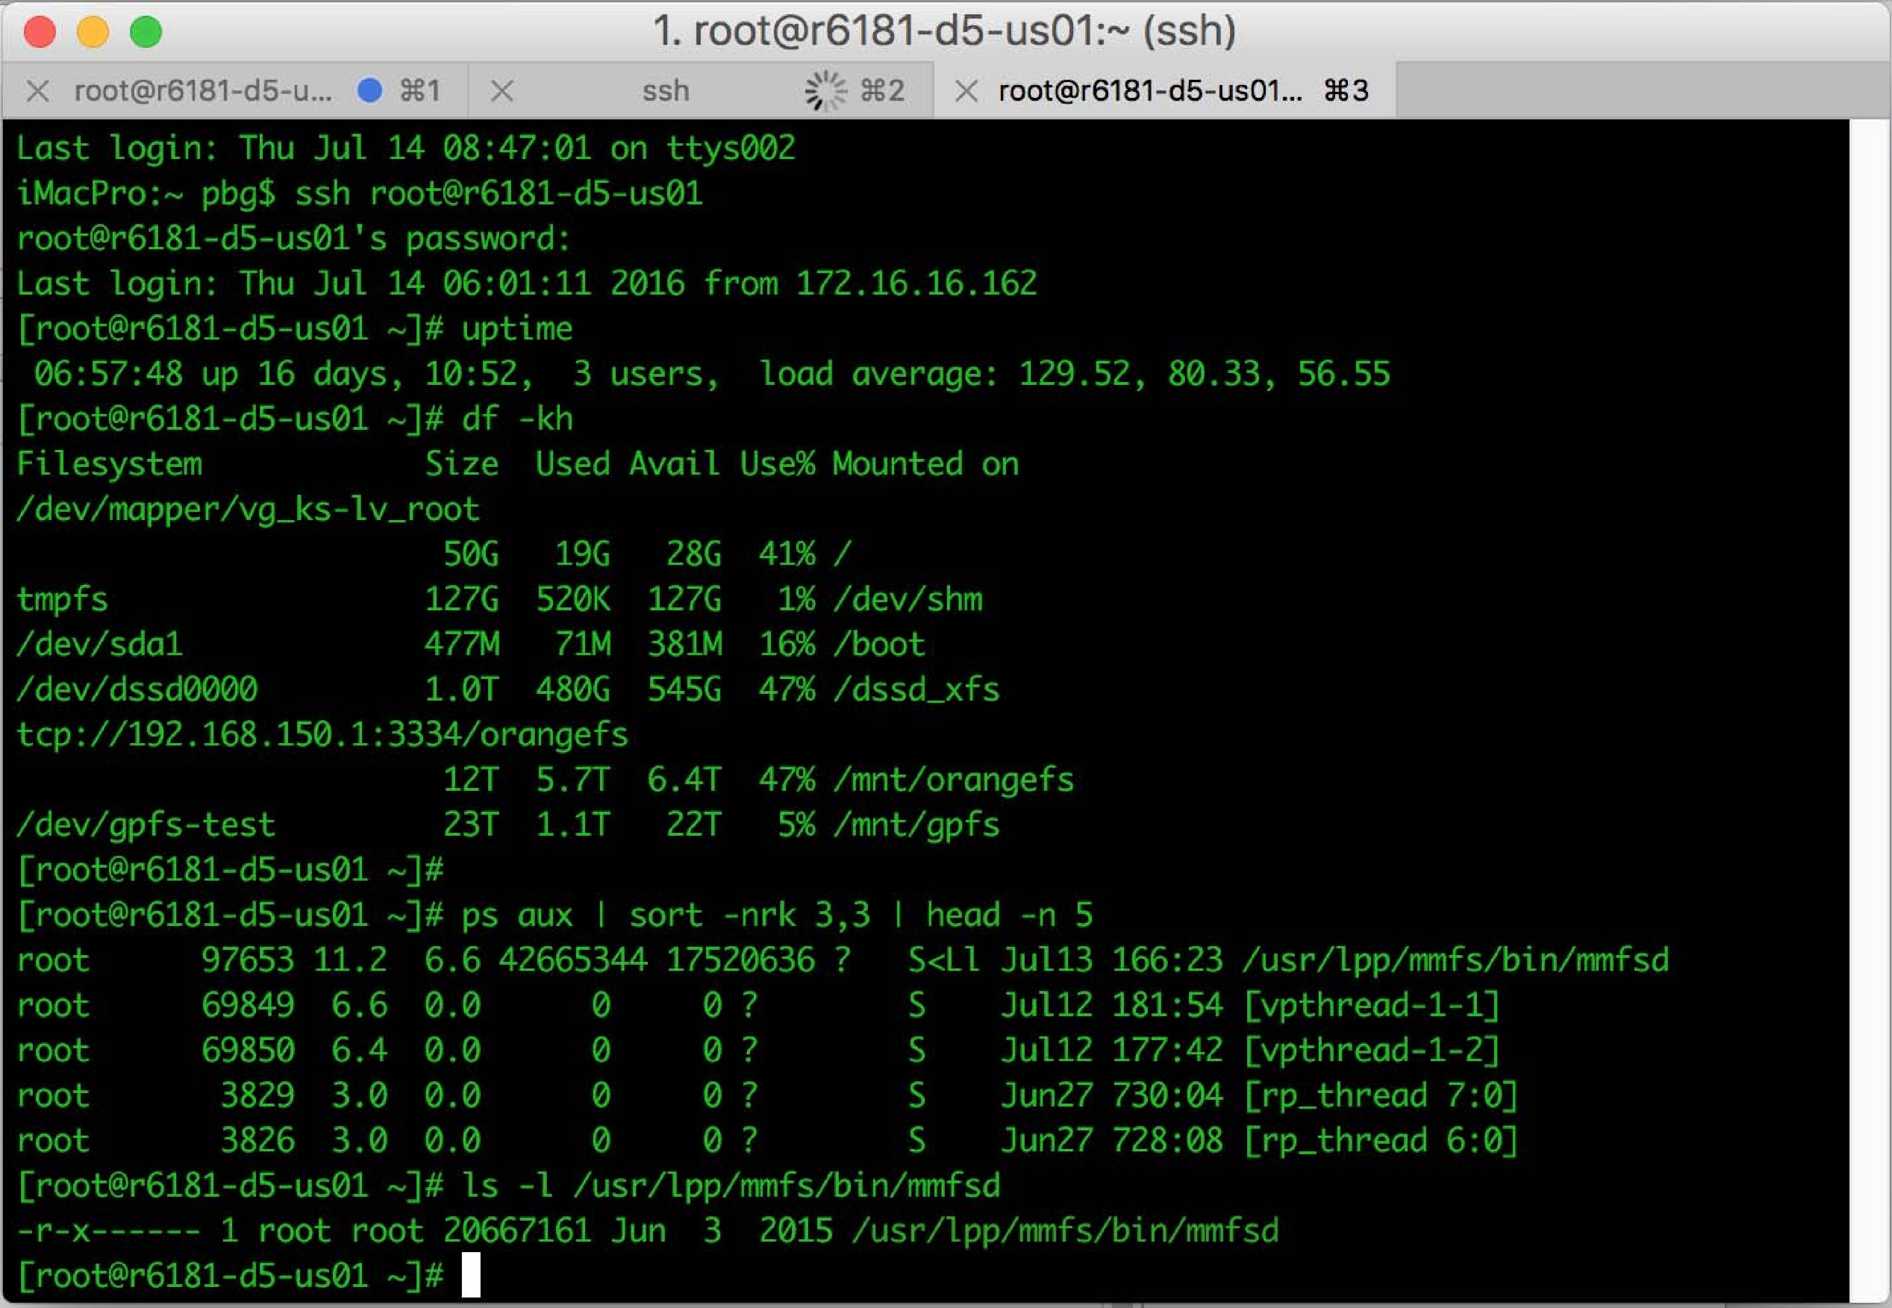
Bourne Shell Command Interpreter

Slide 10
User Operating System Interface - GUI
User-friendly desktop metaphor interface
Usually mouse, keyboard, and monitor
Icons represent files, programs, actions, etc
Various mouse buttons over objects in the interface cause various actions (provide information, options, execute function, open directory (known as a folder)
Invented at Xerox PARC
Many systems now include both CLI and GUI interfaces
Microsoft Windows is GUI with CLI “command” shell
Apple Mac OS X is “Aqua” GUI interface with UNIX kernel underneath and shells available
Unix and Linux have CLI with optional GUI interfaces (CDE, KDE, GNOME)

Slide 11

Touchscreen Interfaces
Touchscreen devices require new interfaces
Mouse not possible or not desired
Actions and selection based on gestures
Virtual keyboard for text entry
Voice commands

Slide 12
The Mac OS X GUI

Slide 13
System Calls
Programming interface to the services provided by the OS
Typically written in a high-level language (C or C++)
Mostly accessed by programs via a high-level Application Programming Interface (API) rather than direct system call use
Three most common APIs are Win32 API for Windows, POSIX API for POSIX-based systems (including virtually all versions of UNIX, Linux, and Mac OS X), and Java API for the Java virtual machine (JVM)

Slide 14
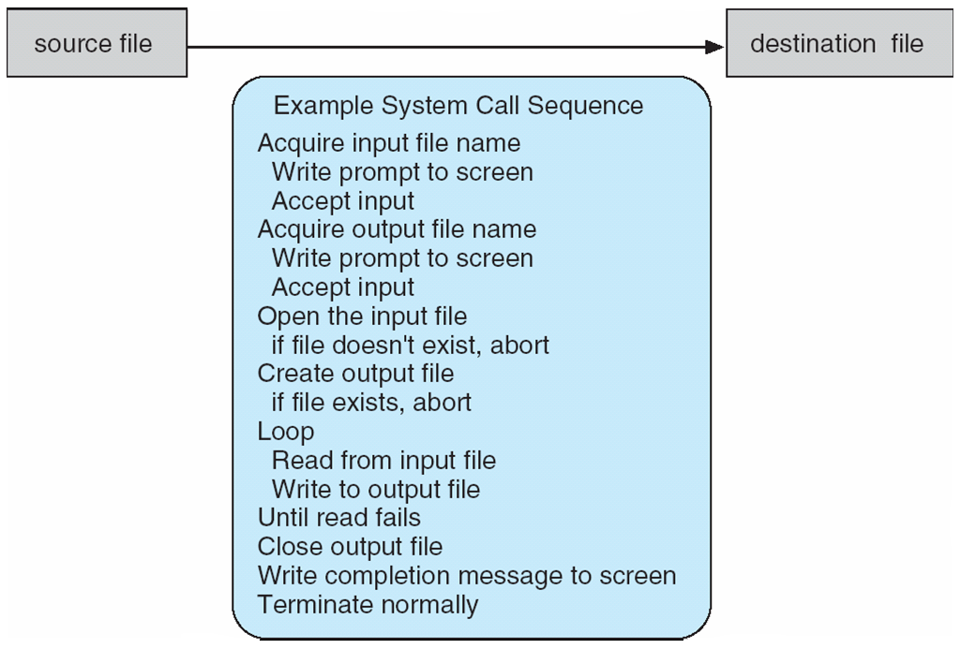
Example of System Calls
System call sequence to copy the contents of one file to another file

Slide 15
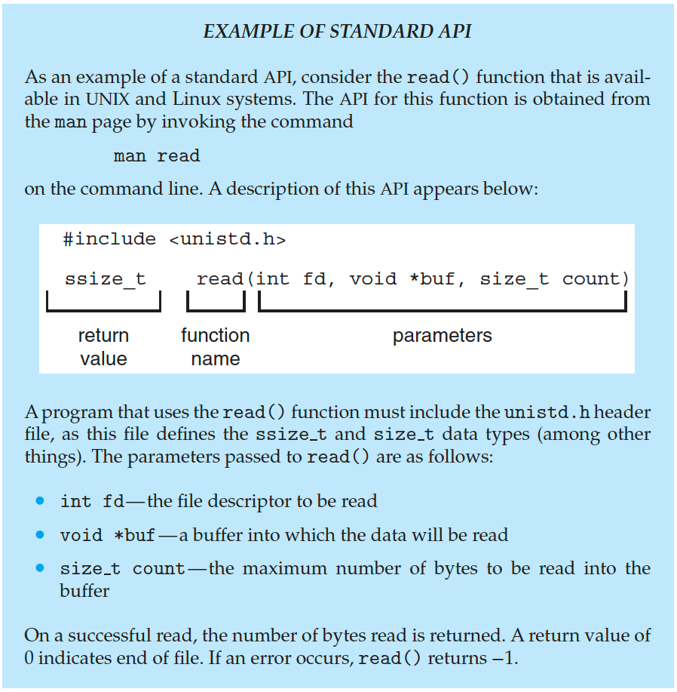
Example of Standard API

Slide 16
System Call Implementation
System call allows user level processes to request some services from OS which process itself is not allowed to do.
Typically, a number is associated with each system call
System-call interface maintains a table indexed according to these numbers
The system call interface invokes the intended system call in OS kernel and returns status of the system call and any return values
The caller need know nothing about how the system call is implemented
Just needs to obey API and understand what OS will do as a result call
Most details of OS interface hidden from programmer by API

Slide 17

API – System Call – OS Relationship

Slide 18
System Call Parameter Passing
Often, more information is required than simply identity of desired system call
Exact type and amount of information vary according to OS and call
Three general methods used to pass parameters to the OS
Simplest: pass the parameters in registers
In some cases, may be more parameters than registers
Parameters stored in a block, or table, in memory, and address of block passed as a parameter in a register
This approach taken by Linux and Solaris
Parameters placed, or pushed, onto the stack by the program and popped off the stack by the operating system

Slide 19
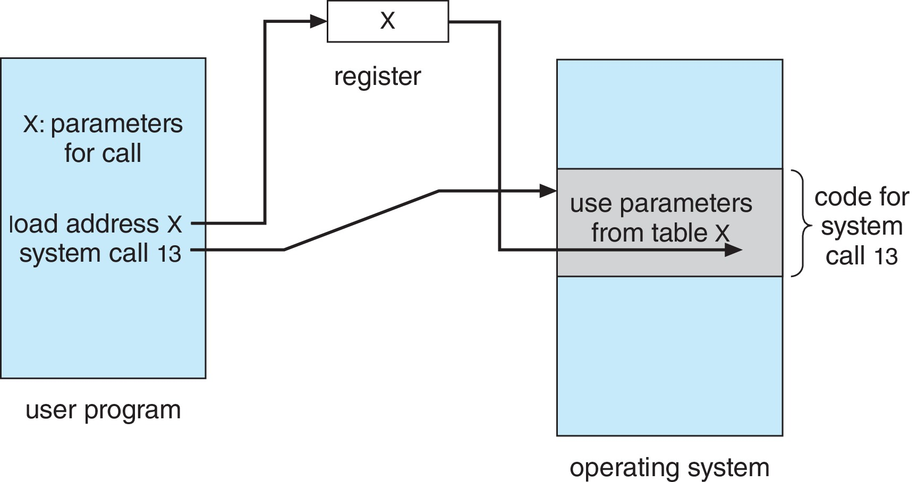
Parameter Passing via Table

Slide 20
Types of System Calls
Process control
create process, terminate process
End(exit from program), abort(i/o requirement are not fulfilled)
load, execute
get process attributes(priority or protection), set process attributes
wait for time
wait event, signal event
allocate and free memory

Slide 21
Types of System Calls (Cont.)
File management
create file, delete file
open, close file
read, write, reposition
get and set file attributes
Device management
request device, release device
read, write, reposition
get device attributes, set device attributes
logically attach or detach devices

Slide 22
Types of System Calls (Cont.)
Information maintenance
get time or date, set time or date
get system data, set system data
get and set process, file, or device attributes
Communications
create, delete communication connection
send, receive messages if message passing model to host name or process name(example mail box)
From client to server
Shared-memory model create and gain access to memory regions
transfer status information
attach and detach remote devices

Slide 23
Types of System Calls (Cont.)
Protection
Control access to resources
Get and set permissions
Allow and deny user access

Slide 24
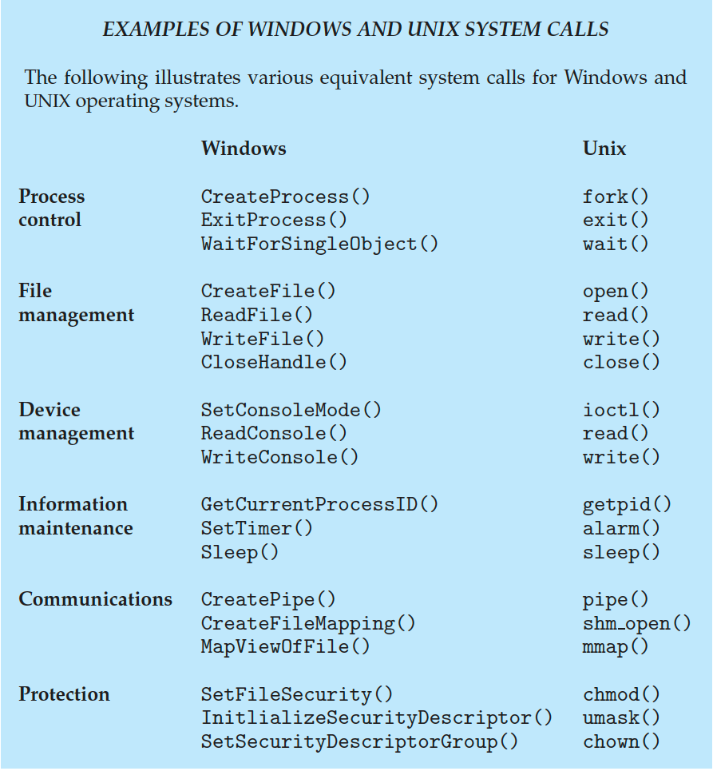
Examples of Windows and Unix System Calls

Slide 25
Operating System Structure
General-purpose OS is very large program
Various ways to structure ones
Simple structure – MS-DOS
Layered structure
Microkernel structure
Modular structure

Slide 26
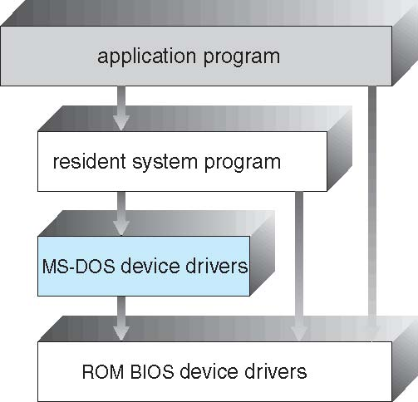
Simple Structure -- MS-DOS
Such OS do not have well defined structure and are small and simple
Interfaces and levels of functionality are not well separated.
Not divided into modules
Although MS-DOS has some structure, its interfaces and levels of functionality are not well separated
The functionality of any layer is not defined
Debugging and maintenance is difficult
Any layer can access the other layers
These OS cause entire system to crash if one of user program fails

Slide 27
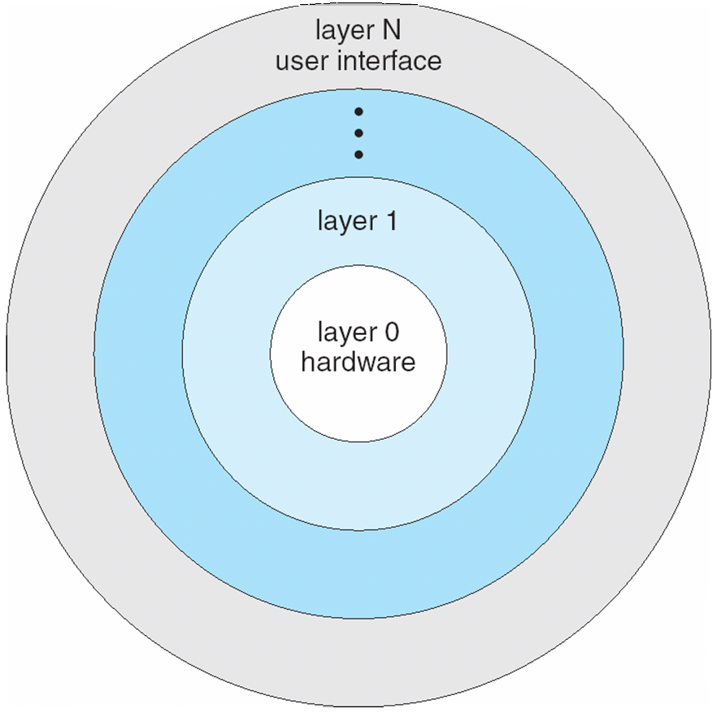
Layered Approach
The operating system is divided into a number of layers (levels), each built on top of lower layers. The bottom layer (layer 0), is the hardware; the highest (layer N) is the user interface.
With modularity, layers are selected such that each uses functions (operations) and services of only lower-level layers
If error is found during debugging of a particular layer, the error must be on that layer
Disadvantage : careful definition of each layer

Slide 28
Microkernels
Moves nonessential component from the kernel into user space
Mach is an example of microkernel
Mac OS X kernel (Darwin) partly based on Mach
Communication takes place between user modules using message passing
Benefits:
Easier to extend a microkernel
More reliable (less code is running in kernel mode)
More secure, if any micro kernel fails then the remaining OS remains untouched and works fine.
Disadvantage
Increased intermodule communication reduces system performance.
System is complex to be constructed.

Slide 29
Microkernel System Structure

Slide 30
Modular
Many modern operating systems implement loadable kernel modules (LKMs)
Uses object-oriented approach
Each core component is separate
Each talks to the others over known interfaces
Each is loadable as needed within the kernel
Overall, similar to layers but with more flexible
Linux, Solaris, etc.

Slide 31
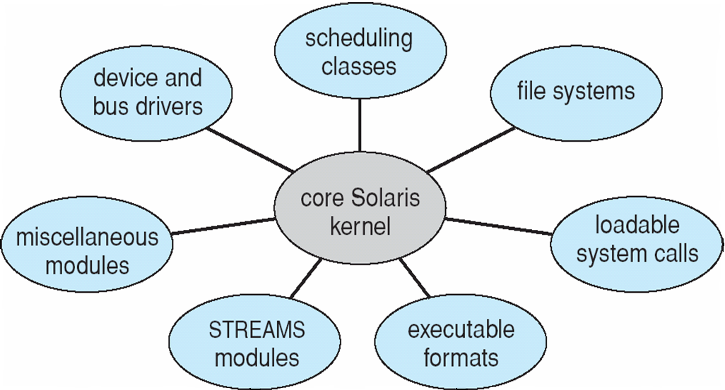
Solaris Modular Approach

Slide 32
End of Chapter 2

